Slide 1
NG iDesign Team Phase 1
Team Members: Youssef Samwel, Nicolas Sayeed, Pablo Rodriguez, Davi Dantas, Evan Kasky, Timothy Ogg
Advisors: Dr. Mike Borowczak and Dr. Chung Yong Chan

Slide 2
Project Overview
Design an ASIC implementing the RISC-V RV32I base instruction set, except for memory ordering and environment/system calls.
Perform functional and/or formal verification of the design to confirm functionality of the design. Use the Universal Verification Methodology (UVM) standardized methodology. Target a minimum of 85% code coverage.
Synthesize the hardware description language into a netlist for physical layout. Target the 45nm FreePDK45 technology using the Nangate open cell library.
The design should be capable of processing 100 million instructions per second (100 MIPS) within the operating range of 0.95-1.25V and 0-125°C and consume a maximum of 1W. Additionally, the design should incorporate an L1 cache of at least 16MB.
Test the performance and system-level functionality of the design by creating and executing test cases in RV32I assembly.

Slide 3
Teams Dynamics
Design Team – Youssef & Nicolas
System Design
Established modular requirements
Worked on redesigns
Memory Team – Pablo & Timothy
Worked on establishing the cache subsystem
Established functionality of IF & MEM
Testing of memory stage
Verification Team – Davi & Evan
Verified essential units; Execution & Decoder
Worked on early UVM reports & Assertion-based Testbenches

Slide 4
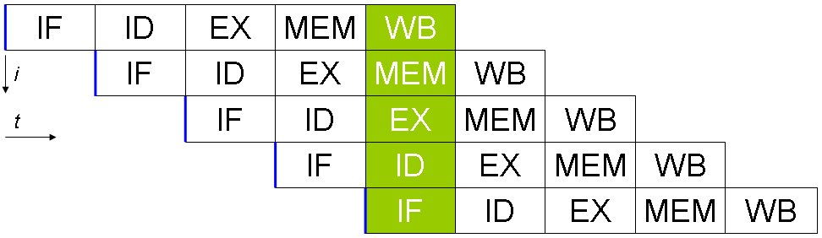
Summary of Design Requirements
Simple RTL logic
Support the 37 RISC instructions
Use the classic 5-stage pipeline

Slide 5
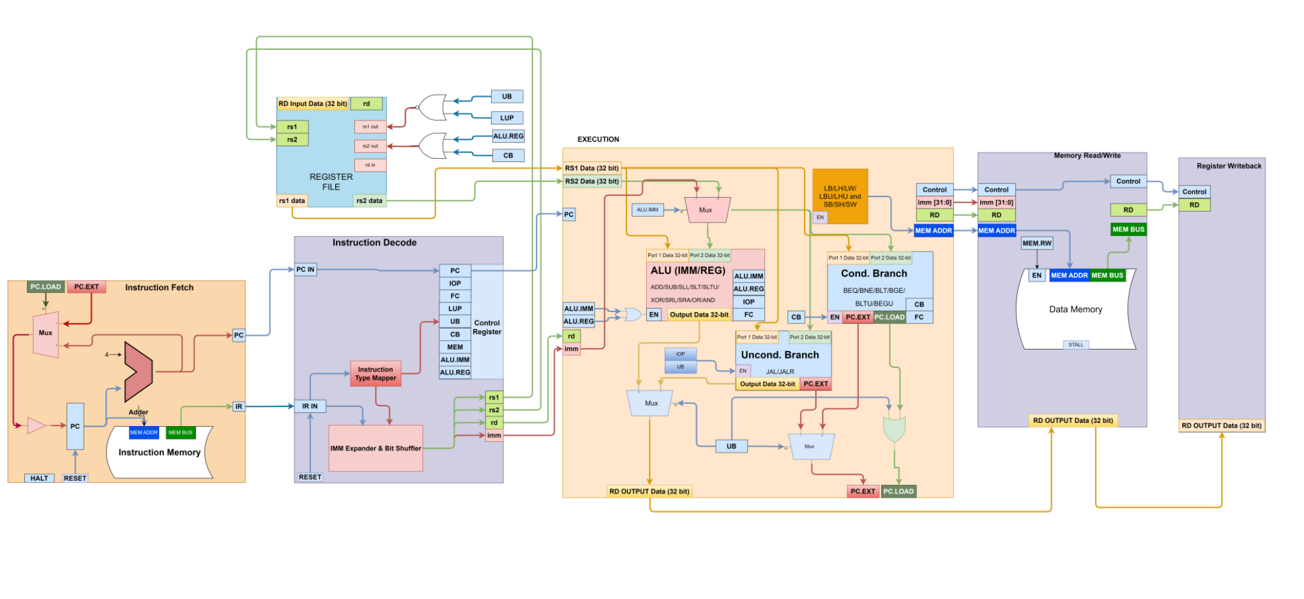
RAPID Core

Slide 6
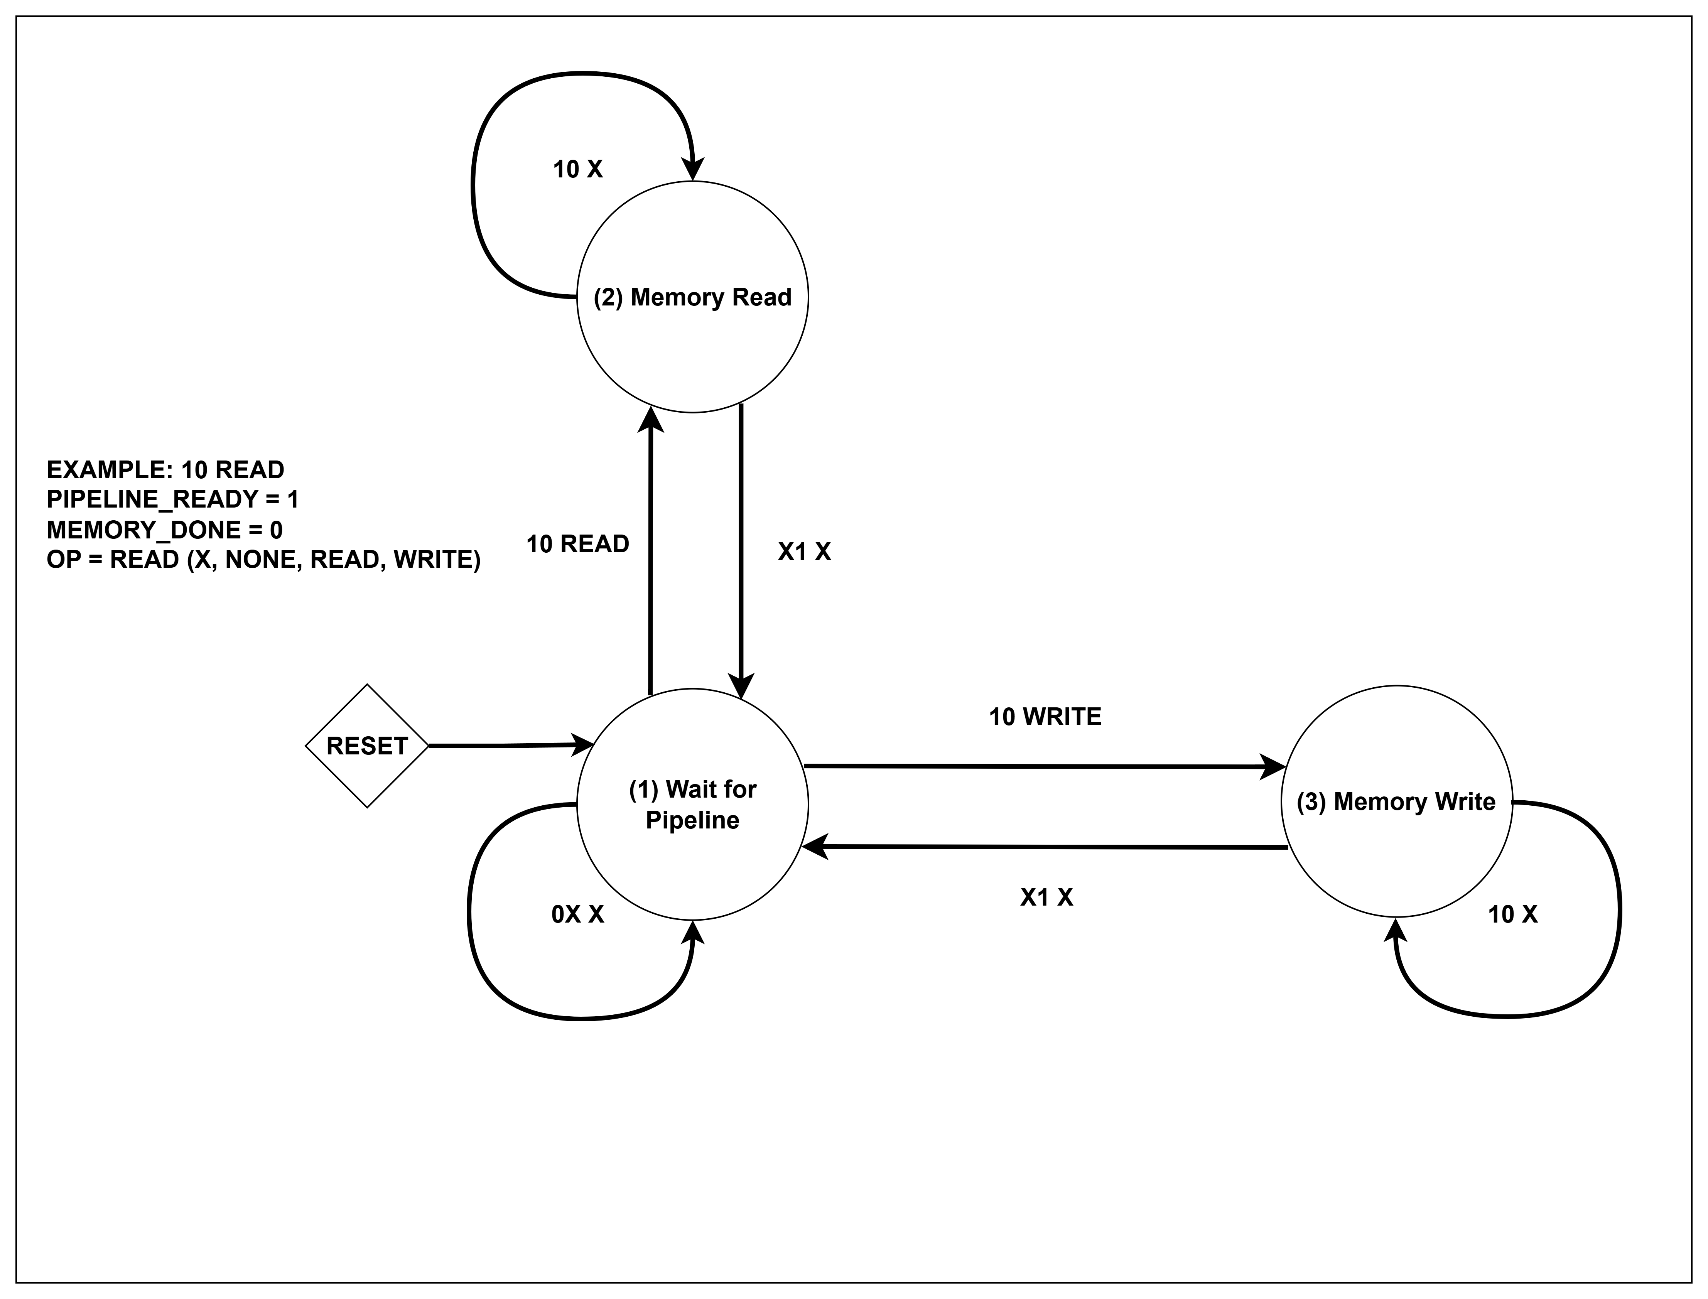
RAPID Core – MEM FSM

Slide 7
Feedback from Early Testing
Development of testbenches
Inspection of Architecture
Performance

Slide 8
Why redesign RAPID?
Race conditions in microarchitecture.
High CPI and high latency.
Could not meet power requirement with realized CPI.

Slide 9
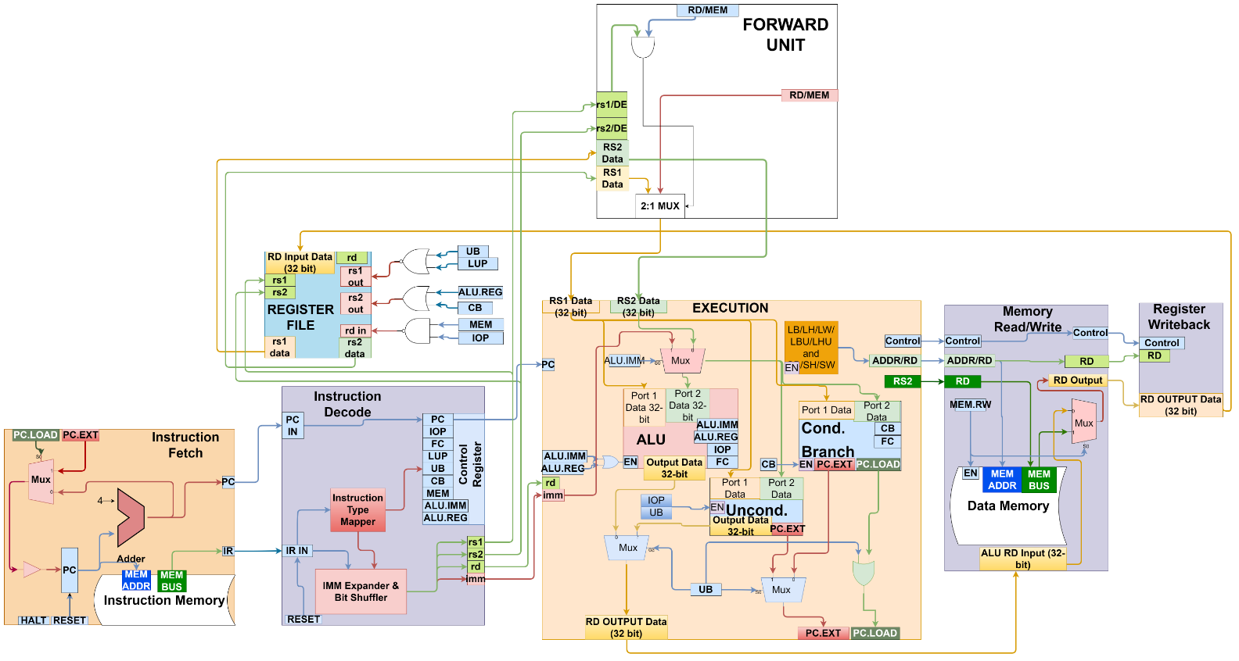
RAPID-X Core
4-Stage Pipeline
Optimized FSM
Combinational logic
Resolve Race Conditions

Slide 10
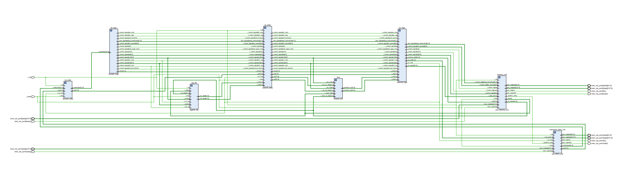
RAPID-X Core

Slide 11
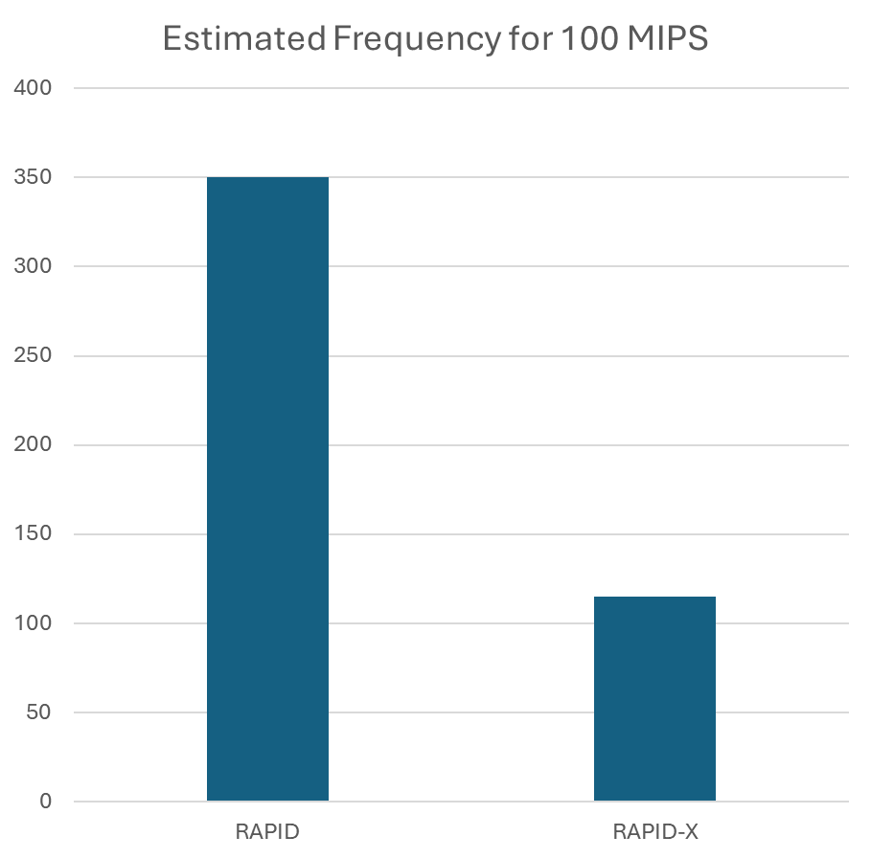
Frequency and Power Requirement
Reduced core clock speed requirement from ~350 MHz to ~115 MHz

Slide 14
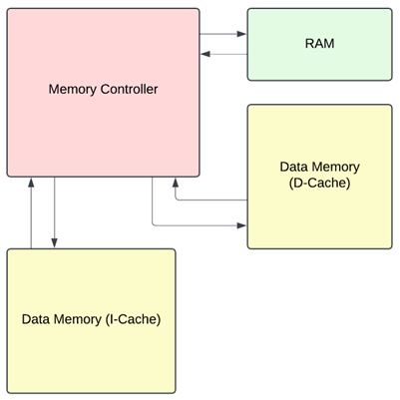
Cache Subsystem
16 MB L1 Cache
Split cache D-Cache & I-Cache
Direct Mapped
Modular cache for instantiation
Initial Block Diagram

Slide 15
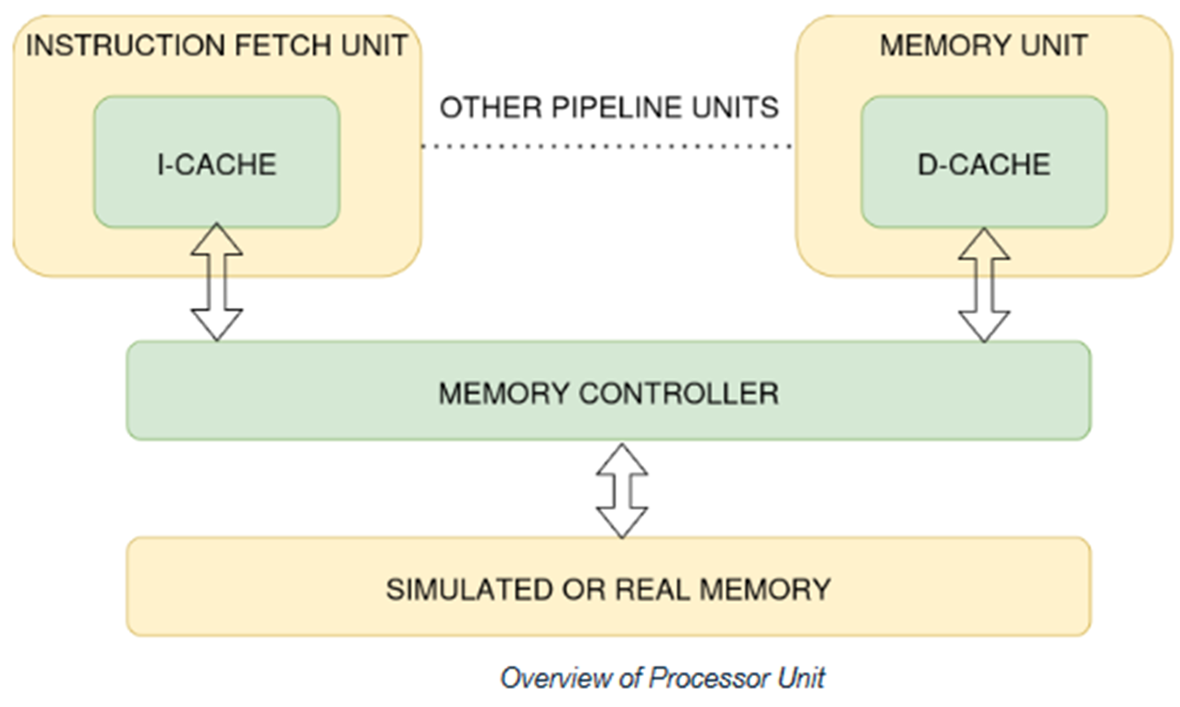
Cache Subsystem
Cache module is instantiated separately for the I-Cache and D-Cache
Better code re-usability
Per-cache optimization (size, associativity) using instance parameters
Simulated memory is initialized at startup

Slide 16
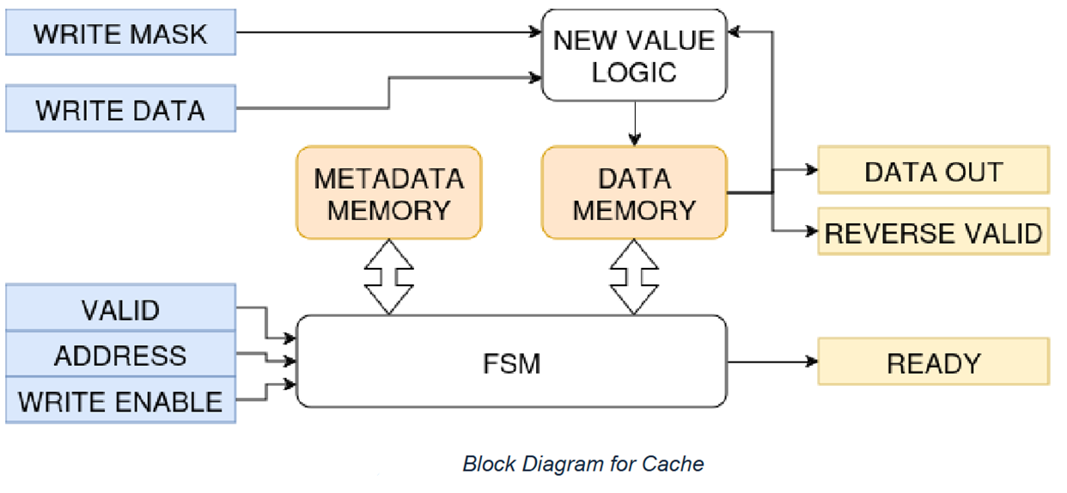
Cache Subsystem
Simple ready/valid protocol provides robust synchronization and signaling between cache subsystem and CPU pipeline.
Cache utilizes two (very fast) SRAM blocks internally.

Slide 17
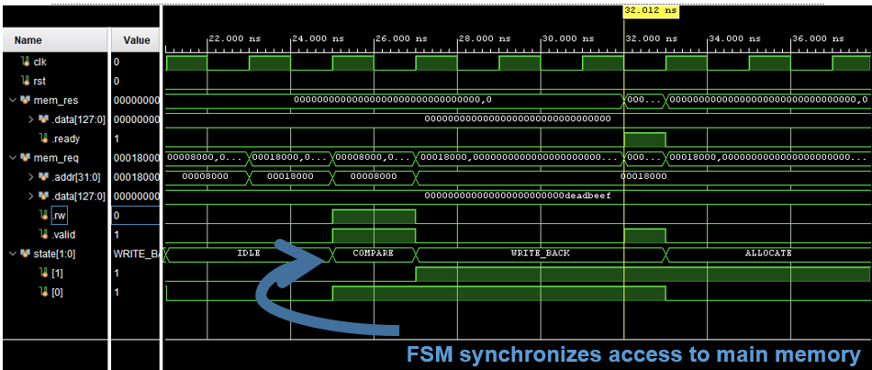
Cache signals in waveform viewer

Slide 18
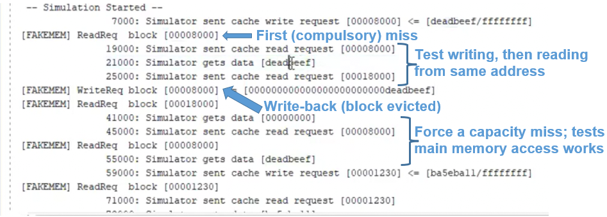
Cache and fake memory simulation log

Slide 19
Instruction Fetch Testing
Preload sequence of instructions
Validate FSM transitions, PC updates, and cache communication
Simulate edge cases
Sequential fetching when the pipeline ready flag is 1
Produce a no op for memory stalls
Correct synchronization with pipeline and accurate instructions delivery

Slide 20
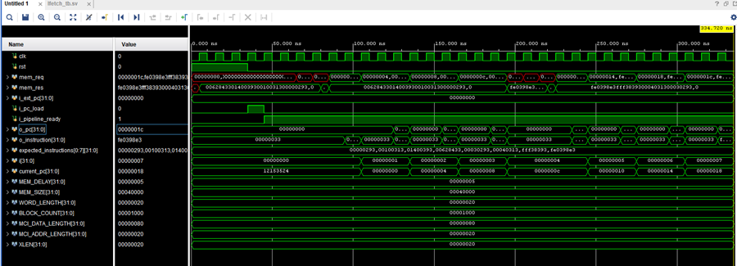
Testing Waveforms and logs

Slide 21
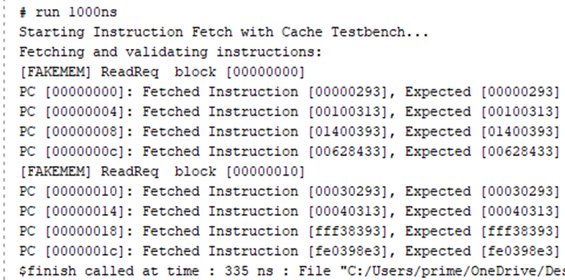
Testing Waveforms and logs

Slide 22
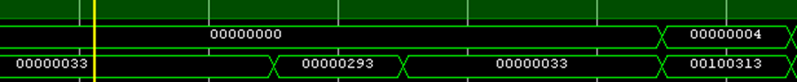
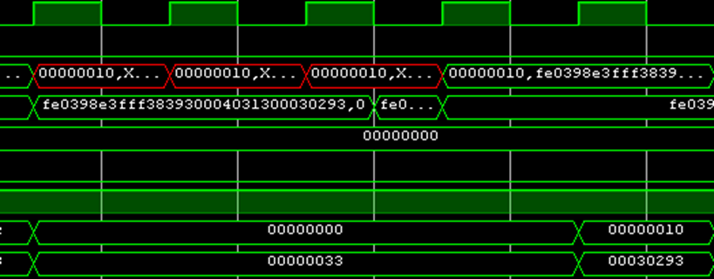
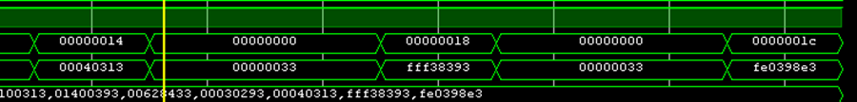
Testing Waveforms and logs

Slide 23
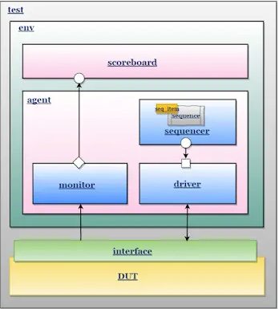

Verification

Slide 24

Platform
Link
EDA Playground

Slide 25

Obstacles
Learning Curve
Crawl, Walk, Run – Building blocks
Code Dependency – Execute Stage
Adapt to module updates

Slide 26
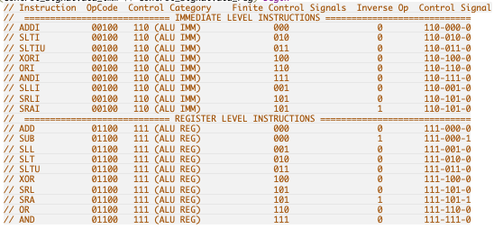
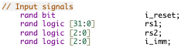
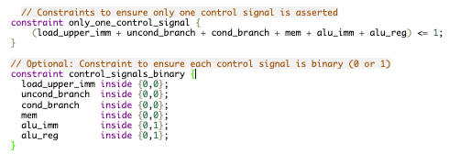
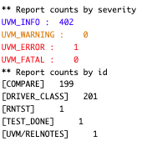

Slide 27
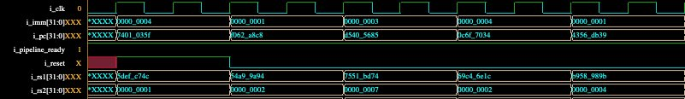

Slide 28
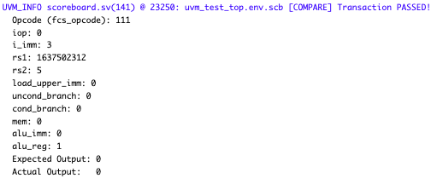
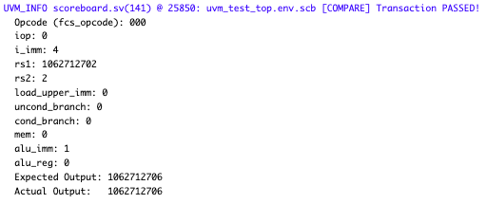
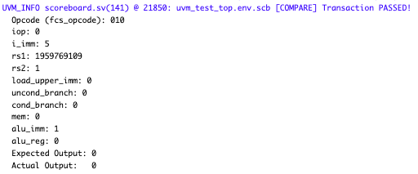
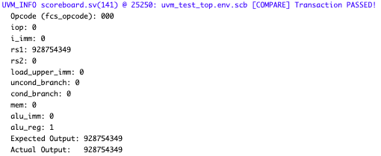
Results Examples
AND
ADDI
SLTI
ADD

Slide 29
Obstacles
UVM Learning Curve
Understanding UVM concepts such as sequences, agents, and virtual interfaces was a long process
Initially not knowing if my lack of UVM knowledge was the reason for failure or there was an issue with the design
Core / Signal Redesign
Adapting existing testbenches to the new design requires significant time
Adds lengthy debug process to find errors where existing testbench gives an error

Slide 30
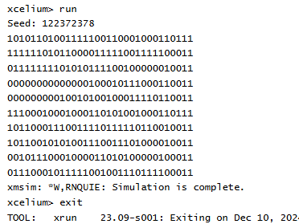
Custom Instruction Generator
Custom SystemVerilog module to generate random valid instructions
Outputs a random valid 32-bit RISC-V instruction
Generates valid random data depending on the instruction type
Properly encodes(combines) the bits into a 32-bit instruction
Still working on integrating into existing UVM testbench

Slide 31
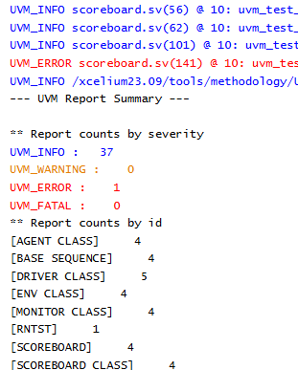
Initial Instruction Decoder UVM
Learning and Resources
Watched Cadence UVM training modules for foundational understanding.
Watched other UVM training resources online
Progress
Framework for the decode stage of the UVM testbench has been set up.
Basic testbench infrastructure is operational.
Current Gaps
Custom instruction generator is developed but not yet integrated into the testbench/DUT.
DUT is not producing the correct iop signals as expected.
Next Steps
Integrate the custom instruction generator with the UVM testbench.
Debug and fix the issue in the DUT logic affecting the iop signal generation.
Ensure all instructions are properly being decoded

Slide 32
Test Program: Fib Gen
addi x5, x0, 0 # F0
addi x6, x0, 1 # F1
addi x7, x0, 20 # Number of iterations
loop:
add x8, x5, x6 # F_next = F0 + F1
addi x5, x6, 0 # F0 = F1
addi x6, x8, 0 # F1 = F_next
addi x7, x7, -1
bne x7, x0, loop

Slide 33
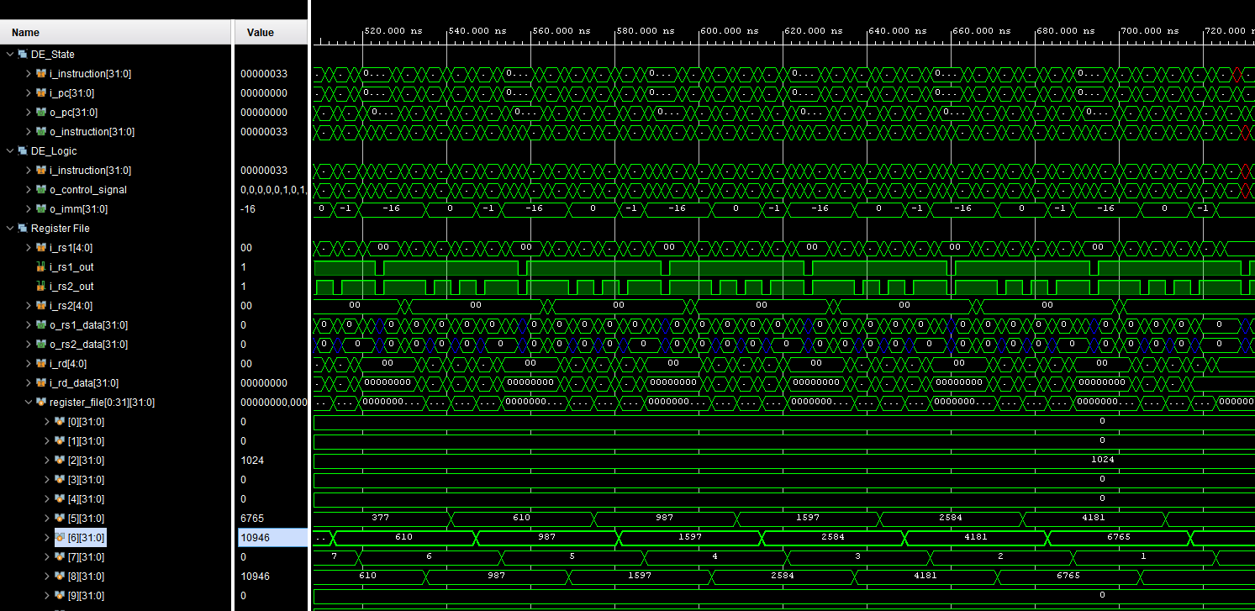
Test Program: Fib Gen

Slide 34
Benchmark: XOR LOOP
SumXOR_Loop
Metric | X | Reference | RAPID
Time | 113352 | N/A | 340065
Clocks | 56676 | 70008 | 170032.5
Instr | 50,006 | 50,006 | 50,006
CPI | 1.133383994 | 1.399992001 | 3.400241971
IPC | 0.882313501 | 0.714289795 | 0.294096717
% Up | 300.0079399 | 242.8758142 | 100
Freq | 113 | 140 | 340
li t0, 0 # Initialize sum to 0
li t1, 0 # Initialize XOR result to 0
li t2, 10000 # Loop counter (large number)
li t3, 1 # Increment value
loop:
add t0, t0, t3 # Add increment to sum
xor t1, t1, t3 # XOR current value with t1
addi t3, t3, 1 # Increment current value
addi t2, t2, -1 # Decrement loop counter
bne t2, x0, loop # Repeat if counter not zero
nop

Slide 36
Management Tools
AGILE Methodology
Regular weekly meetings
Established collaborative spaces
Discord
GitHub
OneDrive
Followed timelines to meet milestones

Slide 37
Plan for Phase 2
Finalize functional and/or formal verification of the design, adhering to the target code coverage.
Use electronic design tools to perform physical design and create a layout of the design.
Conduct static timing analysis (STA), IR drop, and electromigration analysis to ensure physical performance requirements are met. Target a maximum IR drop of 5% with no timing failures and maximum current density within limits.
Use physical design techniques such as design rule checking (DRC) to establish design manufacturability and layout versus schematic (LVS) to ensure correctness of the physical design.

Slide 38
THANK YOU FOR THE SUPPORT!!!

